Slide 1
import statement

Slide 2
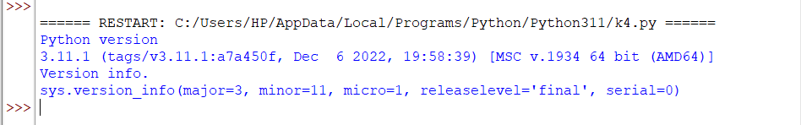
Write a Python program to find out what version of Python you are using.
import sys
print("Python version")
print (sys.version)
print("Version info.")
print (sys.version_info)

Slide 3
print (sys.version)
A string containing the version number of the Python interpreter plus additional information on the build number and compiler used.
This string is displayed when the interactive interpreter is started.
print (sys.version_info)
Version info is a tuple containing the five components of the version number: major, minor, micro, releaselevel, and serial.
All values except releaselevel are integers; the release level is 'alpha', 'beta', 'candidate', or 'final'.
The version_info value corresponding to the Python version 2.0 is (2, 0, 0, 'final', 0).
Note : 'sys' module provides access to variables used or maintained by the interpreter and to functions that interact with the interpreter.

Slide 4
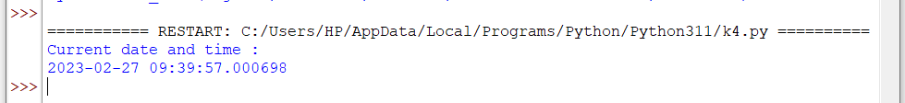
Write a Python program to display the current date and time.
import datetime
now = datetime.datetime.now()
print ("Current date and time : ")
print (now)

Slide 5
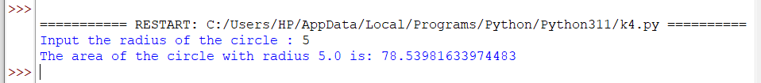
Write a Python program that calculates the area of a circle based on the radius entered by the user.
from math import pi
r = float(input ("Input the radius of the circle : "))
print ("The area of the circle with radius " + str(r) + " is: " + str(pi * r**2))

Slide 6
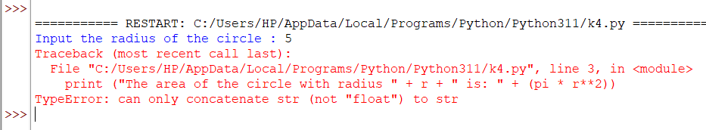

Slide 7
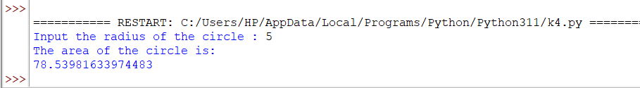
Write a Python program that calculates the area of a circle based on the radius entered by the user.
from math import pi
r = float(input ("Input the radius of the circle : "))
area=pi * r**2
print ("The area of the circle is:")
print(area)

Slide 8
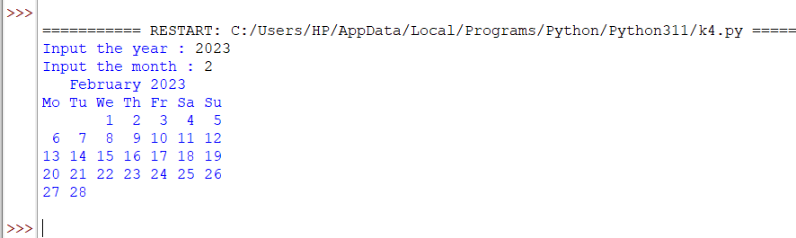
Write a Python program that prints the calendar for a given month and year.
import calendar
y = int(input("Input the year : "))
m = int(input("Input the month : "))
print(calendar.month(y, m))

Slide 9
Python Collections
Four built-in data types in Python used to store collections of data:
List
Tuple
Set and
Dictionary
All the above datatypes have different qualities and usage.

Slide 10
Python Collections (Arrays)
There are four collection data types in the Python programming language:
List is a collection which is ordered and changeable. Allows duplicate members.
Tuple is a collection which is ordered and unchangeable. Allows duplicate members.
Set is a collection which is unordered, unchangeable*, and unindexed. No duplicate members.
Dictionary is a collection which is ordered** and changeable. No duplicate members.
*Set items are unchangeable, but you can remove and/or add items whenever you like.
**As of Python version 3.7, dictionaries are ordered. In Python 3.6 and earlier, dictionaries are unordered.

Slide 11
Python Lists

Slide 12
Python Lists
A list is created in Python by placing items inside square brackets [], separated by commas .
Create a List:
thislist = ["apple", "banana", "cherry"] print(thislist)
Create a List:
numbers = [1, 2, 5]
print(numbers)

Slide 13
List Items
List items are ordered, changeable, and allow duplicate values.
List items are indexed, first item has index [0], the second item has index [1] etc.
Lists are Ordered: it means that the items have a defined order, and that order will not change. If you add new items to a list, the new items will be placed at the end of the list.
Lists are Changeable: meaning that we can change, add, and remove items in a list after it has been created.
Lists allows Duplicates: Since lists are indexed, lists can have items with the same value:
thislist = ["apple", "banana", "cherry", "apple", "cherry"] print(thislist)

Slide 14
List Length
To determine how many items a list has, use the len() function:
Print the number of items in the list:
thislist = ["apple", "banana", "cherry"] print(len(thislist))

Slide 15
List Items - Data Types
List items can be of any data type:
Example
list1 = ["apple", "banana", "cherry"] list2 = [1, 5, 7, 9, 3] list3 = [True, False, False]
A list can contain different data types:
list1 = ["abc", 34, True, 40, "male"]

Slide 16
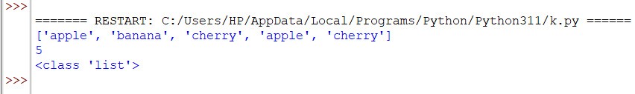
type()
From Python's perspective, lists are defined as objects with the data type 'list': <class 'list'>
thislist = ["apple","banana","cherry","apple","cherry"]
print(thislist)
print(len(thislist))
print(type(thislist))

Slide 17
The list() Constructor
It is also possible to use the list() constructor when creating a new list.
Using the list() constructor to make a List:
thislist = list(("apple", "banana", "cherry"))
print(thislist)

Slide 18
Access List Items
Access Items
List items are indexed and you can access them by referring to the index number:
Print the second item of the list:
thislist = ["apple", "banana", "cherry"] print(thislist[1])
OUTPUT: banana
Note: The first item has index 0.

Slide 19
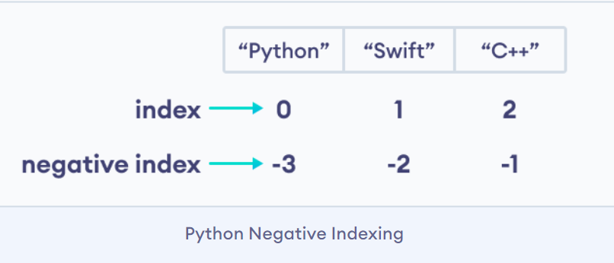
Negative Indexing
Negative indexing means start from the end
-1 refers to the last item, -2 refers to the second last item etc.
Print the last item of the list:
thislist = ["apple", "banana", "cherry"] print(thislist[-1])
OUTPUT: cherry

Slide 20
Range of Indexes
You can specify a range of indexes by specifying where to start and where to end the range.
When specifying a range, the return value will be a new list with the specified items.
Return the third, fourth, and fifth item:
thislist = ["apple", "banana", "cherry", "orange", "kiwi", "melon", "mango"] print(thislist[2:5])
OUTPUT: ['cherry', 'orange', 'kiwi']
Note: The search will start at index 2 (included) and end at index 5 (not included).

Slide 21
Range of Indexes
By leaving out the start value, the range will start at the first item:
This example returns the items from the beginning to, but NOT including, "kiwi":
thislist = ["apple", "banana", "cherry", "orange", "kiwi", "melon", "mango"] print(thislist[:4])
OUTPUT: ['apple', 'banana', 'cherry', 'orange']

Slide 22
Range of Indexes
By leaving out the end value, the range will go on to the end of the list:
This example returns the items from "cherry" to the end:
thislist = ["apple", "banana", "cherry", "orange", "kiwi", "melon", "mango"]
print(thislist[2:])
OUTPUT: ['cherry', 'orange', 'kiwi', 'melon', 'mango']

Slide 23
Range of Negative Indexes
Specify negative indexes if you want to start the search from the end of the list:
This example returns the items from "orange" (-4) to, but NOT including "mango" (-1):
thislist = ["apple", "banana", "cherry", "orange", "kiwi", "melon", "mango"] print(thislist[-4:-1])
OUTPUT: ['orange', 'kiwi', 'melon']
Negative indexing means starting from the end of the list. This example returns the items from index -4 (included) to index -1 (excluded).
Remember that the last item has the index -1

Slide 24
Check if Item Exists
To determine if a specified item is present in a list use the in keyword:
Check if "apple" is present in the list:
thislist = ["apple", "banana", "cherry"]
if "apple" in thislist:
print("Yes, 'apple' is in the fruits list")

Slide 25

Check if Item Exists
thislist = ["banana","cherry"]
if "apple" in thislist:
print("Yes, 'apple' is in the fruits list")
else:
print ("No, 'apple' is not in the fruit list")

Slide 26
Change List Items
Python lists are mutable.
Meaning lists are changeable.
And, we can change items of a list by assigning new values using = operator.

Slide 27
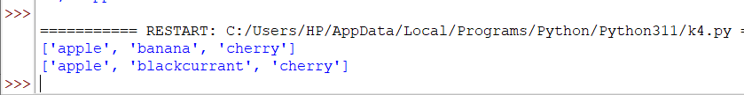
Change List Items
Change Item Value
To change the value of a specific item, refer to the index number:
Change the second item:
thislist = ["apple", "banana", "cherry"] print(thislist)
thislist[1] = "blackcurrant" print(thislist)

Slide 28
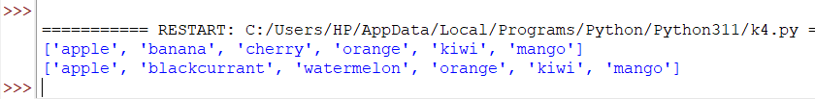
Change a Range of Item Values
To change the value of items within a specific range, define a list with the new values, and refer to the range of index numbers where you want to insert the new values:
Change the values "banana" and "cherry" with the values "blackcurrant" and "watermelon":
thislist = ["apple", "banana", "cherry", "orange", "kiwi", "mango"]
print(thislist)
thislist[1:3] = ["blackcurrant", "watermelon"]
print(thislist)

Slide 29
Change a Range of Item Values
If you insert more items than you replace, the new items will be inserted where you specified, and the remaining items will move accordingly:
Change the second value by replacing it with two new values:
thislist = ["apple", "banana", "cherry"] thislist[1:2] = ["blackcurrant", "watermelon"] print(thislist)
OUTPUT: ['apple', 'blackcurrant', 'watermelon', 'cherry']
Note: The length of the list will change when the number of items inserted does not match the number of items replaced.

Slide 30
Change a Range of Item Values
If you insert less items than you replace, the new items will be inserted where you specified, and the remaining items will move accordingly:
Change the second and third value by replacing it with one value:
thislist = ["apple", "banana", "cherry"] thislist[1:3] = ["watermelon"] print(thislist)
OUTPUT: ['apple', 'watermelon']

Slide 31
Insert Items
To insert a new list item, without replacing any of the existing values, we can use the insert() method.
The insert() method inserts an item at the specified index:
Example : Insert "watermelon" as the third item:
thislist = ["apple", "banana", "cherry"]
thislist.insert(2, "watermelon")
print(thislist)
OUTPUT: ['apple', 'banana', 'watermelon', 'cherry']

Slide 32
Add List Items: Append Items
To add an item to the end of the list, use the append() method:
Using the append() method to append an item:
thislist = ["apple", "banana", "cherry"]
thislist.append("orange")
print(thislist)
OUTPUT: ['apple', 'banana', 'cherry', 'orange']

Slide 33
Extend List
To append elements from another list to the current list, use the extend() method.
Example: Add the elements of tropical to thislist:
thislist = ["apple", "banana", "cherry"]
tropical = ["mango", "pineapple", "papaya"]
thislist.extend(tropical)
print(thislist)
OUTPUT: ['apple', 'banana', 'cherry', 'mango', 'pineapple', 'papaya']
The elements will be added to the end of the list.

Slide 34
Remove List Items
Remove Specified Item
The remove() method removes the specified item.
Example: Remove "banana":
thislist = ["apple", "banana", "cherry"]
thislist.remove("banana")
print(thislist)
OUTPUT: ['apple', 'cherry']

Slide 35
Remove Specified Index
The pop() method removes the specified index.
Example: Remove the second item:
thislist = ["apple", "banana", "cherry"] thislist.pop(1) print(thislist)
OUTPUT: ['apple', 'cherry']
If you do not specify the index, the pop() method removes the last item.
Remove the last item:
thislist = ["apple", "banana", "cherry"] thislist.pop() print(thislist)
OUTPUT: ['apple', 'banana']

Slide 36
The del keyword also removes the specified index:
Example: Remove the first item:
thislist = ["apple", "banana", "cherry"] del thislist[0] print(thislist)
OUTPUT:['banana', 'cherry']
The del keyword can also delete the list completely.
Example: Delete the entire list:
thislist = ["apple", "banana", "cherry"]
del thislist
OUTPUT: NameError: name 'thislist' is not defined

Slide 37
Clear the List
The clear() method empties the list.
The list still remains, but it has no content.
Example: Clear the list content:
thislist = ["apple", "banana", "cherry"] thislist.clear() print(thislist)

Slide 38
Loop Lists
Loop Through a List
You can loop through the list items by using a for loop:
Example: Print all items in the list, one by one:
thislist = ["apple", "banana", "cherry"]
for x in thislist:
print(x)

Slide 39
Loop Through the Index Numbers
You can also loop through the list items by referring to their index number.
Use the range() and len() functions to create a suitable iterable.
Example:Print all items by referring to their index number:
thislist = ["apple", "banana", "cherry"] for i in range(len(thislist)): print(thislist[i])
The iterable created in the example above is [0, 1, 2].

Slide 40
Using a While Loop
You can loop through the list items by using a while loop.
Use the len() function to determine the length of the list, then start at 0 and loop your way through the list items by referring to their indexes.
Remember to increase the index by 1 after each iteration.
Example: Print all items, using a while loop to go through all the index numbers
thislist = ["apple", "banana", "cherry"]
i = 0
while i < len(thislist):
print(thislist[i])
i = i + 1

Slide 41
Example: Based on a list of fruits, you want a new list, containing only the fruits with the letter "a" in the name.
for statement with a conditional test inside:
fruits = ["apple", "banana", "cherry", "kiwi", "mango"] newlist = [] for x in fruits: if "a" in x: newlist.append(x) print(newlist)

Slide 42
List Comprehension
List comprehension offers a shorter syntax when you want to create a new list based on the values of an existing list.
With list comprehension you can do all that with only one line of code:
fruits = ["apple", "banana", "cherry", "kiwi", "mango"] newlist = [x for x in fruits if "a" in x] print(newlist)

Slide 43
List Comprehension: Syntax
newlist = [expression for item in iterable if condition == True]
The return value is a new list, leaving the old list unchanged.
Condition
The condition is like a filter that only accepts the items that valuate to True.
Example: Only accept items that are not "apple":
newlist = [x for x in fruits if x != "apple"]
The condition if x != "apple" will return True for all elements other than "apple", making the new list contain all fruits except "apple".

Slide 44
List Comprehension
The condition is optional and can be omitted:
fruits = ["apple", "banana", "cherry", "kiwi", "mango"]
newlist = [x for x in fruits]
print(newlist)

Slide 45
List Comprehension
You can use the range() function to create an iterable:
newlist = [x for x in range(10)]
OUTPUT: [0, 1, 2, 3, 4, 5, 6, 7, 8, 9]
newlist = [x for x in range(10) if x < 5]
print(newlist)
OUTPUT: [0, 1, 2, 3, 4]

Slide 46
List Comprehension
Expression
The expression is the current item in the iteration, but it is also the outcome, which you can manipulate before it ends up like a list item in the new list:
Set the values in the new list to upper case:
newlist = [x.upper() for x in fruits]
OUTPUT: ['APPLE', 'BANANA', 'CHERRY', 'KIWI', 'MANGO']

Slide 47
Sort Lists: Sort List Alphanumerically
List objects have a sort() method that will sort the list alphanumerically, ascending, by default:
Sort the list alphabetically:
thislist = ["orange", "mango", "kiwi", "pineapple", "banana"] thislist.sort() print(thislist)
OUTPUT: ['banana', 'kiwi', 'mango', 'orange', 'pineapple']
Sort the list numerically:
thislist = [100, 50, 65, 82, 23] thislist.sort() print(thislist)
OUTPUT:[23, 50, 65, 82, 100]

Slide 48
Sort Descending
To sort descending, use the keyword argument reverse = True:
Sort the list descending:
thislist = ["orange", "mango", "kiwi", "pineapple", "banana"] thislist.sort(reverse = True) print(thislist)
OUTPUT: ['pineapple', 'orange', 'mango', 'kiwi', 'banana']
Sort the list descending:
thislist = [100, 50, 65, 82, 23] thislist.sort(reverse = True) print(thislist)

Slide 49
Customize Sort Function
You can also customize your own function by using the keyword argument key = function.
Case Insensitive Sort
By default the sort() method is case sensitive, resulting in all capital letters being sorted before lower case letters:
Case sensitive sorting can give an unexpected result:
thislist = ["banana", "Orange", "Kiwi", "cherry"] thislist.sort() print(thislist)

Slide 50
Perform a case-insensitive sort of the list:
thislist = ["banana", "Orange", "Kiwi", "cherry"] thislist.sort(key = str.lower) print(thislist)

Slide 51
Copy Lists
Copy a List
You cannot copy a list simply by typing list2 = list1, because: list2 will only be a reference to list1, and changes made in list1 will automatically also be made in list2.
There are ways to make a copy, one way is to use the built-in List method copy().
Make a copy of a list with the copy() method:
thislist = ["apple", "banana", "cherry"]
mylist = thislist.copy()
print(mylist)

Slide 52
Copy Lists
Another way to make a copy is to use the built-in method list().
Make a copy of a list with the list() method:
thislist = ["apple", "banana", "cherry"]
mylist = list(thislist)
print(mylist)

Slide 53
Join Lists
Join Two Lists
There are several ways to join, or concatenate, two or more lists in Python.
One of the easiest ways are by using the + operator.
Join two list:
list1 = ["a", "b", "c"] list2 = [1, 2, 3] list3 = list1 + list2 print(list3)

Slide 54
Join Lists
Another way to join two lists is by appending all the items from list2 into list1, one by one:
Append list2 into list1:
list1 = ["a", "b" , "c"]
list2 = [1, 2, 3]
for x in list2:
list1.append(x)
print(list1)

Slide 55
Join Lists
Or you can use the extend() method, which purpose is to add elements from one list to another list:
Use the extend() method to add list2 at the end of list1:
list1 = ["a", "b" , "c"]
list2 = [1, 2, 3]
list1.extend(list2)
print(list1)

Slide 56
